Slide 1
Scales (Melody)
Shredsheets
Chords (Harmony)
3
Drums & Synth
Ear Training

Slide 2
Scales (Melody)
Shredsheets
Chords (Harmony)
3
Drums & Synth
Ear Training

Slide 3
Shredsheets
3
Scales (Melody)
Chords (Harmony)
Drums & Synth
Ear Training

Slide 4
Scales
Knowledge Tree
Basic Theory
What IS a Note?
What’s an Octave?
What’s a Key?
What’s a Scale?
The Major Scale
Why Scales?
Major Scale Modes
What are Scales?

Slide 5
TODO
Port existing functionality to LibGDX
Jam Mode
UI & UX
Synth
MIDI instruments
Waveform Generator
Fourier analysis of notes
Analysis of gain stages
Polyphony
DSP
Input Device Selection
Amp Modeling
Digital Effects
Impulse Responses
Music Generator
Chord Progressions
Drum Patterns

Slide 6
System Design
Composing, recording, and playback platform for live performance
Synthesizer
Guitar amp modeler
Layered looping system
UX
UI
Profile Creation
Quick, Load, Login
Instruments
Self
Band
Input
Output
Processing
Packaging
Documentation
Advertising

Slide 7
DSP & Synth Architecture
Input
Output
Processing
Packaging
Documentation
Advertising
Structure
Tries
Time Signature
BPM
Note Duration
Melodic Progression
6 octaves x 12 degree key
Scale & Mode
Harmonic Progression
degree[] to degree[]
Chord Progression
Dynamics
Volume
Segments
BPM
Length
Child Segments
Rhythm
Melody
Chord Progression
Instrument
Instrument (Guitar)
Channel (Guitar String)
Frequency Range
Overtone Distribution
Dynamics Trie
Overtone Coefficients
Style
Dynamics Coefficient Vectors
Queryable TrieNode<T> Structure
Source Metadata
Cellular Automata Rulesets

Slide 8
Instruments
Drum Machine
Cog Based
1 Cog = 1 Bar
Cogs gathered from tabs
Categorized by
Genre
Song Section
Time signature
Composition
Measure Bar Trie Progressions (drum pattern arrays)
Song Measure Progressions (arrays of arrays)
Musical Similarity Scores
.
3
.
&
&
.
.
4
2
.
.
&
&
.
1
.

Slide 9
Drum Cogs
Shape Encodes Time Signature
.
3
.
&
&
.
.
4
2
.
.
&
&
.
1
.
3
.
.
&
.
3
.
&
&
3
2
4
2
4
2
.
.
&
.
&
&
1
.
1
&
.
1
.

Slide 10
Drum Cogs
.
3
.
Triplets
&
&
.
.
4
2
.
.
&
&
.
1
.
.
.
3
.
2
.
3
.
2
&
3
&
&
.
&
&
&
.
.
.
&
.
.
&
.
4
4
2
2
4
2
.
&
.
.
.
.
.
&
&
&
&
.
1
&
&
1
1
.
1
1
.
.
1
.
12:8 Polyrhythm
Eighth Note (Quaver) Triplets
6:4 Polyrhythm
Quarter Note (Crotchet) Triplets
3:2 Polyrhythm
Half Note (Minim) Triplets

Slide 11
Synth
GABCDEF
♭
♯
Major
+
~
Δ
…
B
G
7
C
D
E
F
A
1
2
3
4
♭
5
6
♭
G
5
A
B
C
D
E
F
6
7
1
2
3
4
3
4
♭
5
6
7
1
E
F
G
A
B
C
D
2
C
1
D
E
F
G
A
B
2
3
4
♭
5
6
7
B
G
7
C
D
E
F
5
A
1
2
3
4
♭
6
♭
G
5
A
B
C
D
E
F
6
7
1
2
3
4
3
4
♭
5
6
7
1
E
F
G
A
B
C
D
2
C
♭
1
D
E
F
G
A
B
2
3
4
5
6
7
B
G
7
C
D
E
F
A
1
2
3
4
♭
5
6
♭
G
A
B
C
D
E
F
5
6
7
1
2
3
4
3
4
♭
5
6
7
1
E
F
G
A
B
C
D
2
C
D
E
F
G
1
2
3
4
♭
5
A
B
6
7
CM7
Dm7
Em7
FM7
G7
Am7
Bm7ø
I
ii
iii
IV
V
vi
vii

Slide 12
Synthesizer
C
1st
2nd
3rd
4th
5th
vii
Chromatic
Octave
Beep
Boop
Blap
Blop
IV
V
vi
Tone
Ionian (Major)
C Ionian
I
ii
iii
Major Scale
I Chord
2
4
6
1
3
5
7
1
1
3
5
7
2
4
6
1

Slide 13
Synthesizer
7
1
C Ionian
1st
2nd
3rd
4th
5th
I Chord
C
Octave
5
6
vii
Chromatic
Beep
Boop
Blap
Blop
3
Tone
4
IV
V
vi
1
2
Ionian (Major)
I
ii
iii
Major Scale

Slide 14
Synthesizer
C
C D E F G A B C
Ionian (Major)
Major Scale
W W h W W W h
1st
2nd
3rd
4th
5th
♭ flat
♯ sharp
Octave
Beep
Boop
Blap
Blop
Tone
I | C Ionian
I
ii
iii
IV
V
vi
vii
Chromatic
D
F
A
C
E
G
B
C
E
G
B
D
F
A
C

Slide 15
Synthesizer
I
ii
iii
IV
V
vi
vii
Chromatic
Beep
Boop
Blap
Blop
Tone
7:B
1:C
7:B
1:C
7:B
1:C
7:B
C Ionian
1:C
I Chord
C
5:G
6:A
5:G
6:A
5:G
6:A
5:G
6:A
3:E
4:F
3:E
4:F
3:E
4:F
3:E
4:F
1:C
2:D
C:1
2:D
1:C
2:D
1:C
Ionian (Major)
2:D
Major Scale

Slide 16
Synthesizer
1^{x5}
1^{x6}
vii
Chromatic
C
C Ionian
Ionian (Major)
I Chord
Major Scale
Beep
Boop
Blap
Blop
6
7
IV
V
vi
Tone
1⁴
1⁵
1⁶
1⁷
Chromatic
4
5
I
ii
iii
6
7
6
7
vii
2
3
C D E F G A B C
4
5
4
5
W W h W W W h
vi
1st
2nd
3rd
4th
5th
2
3
2
3
7
1^{x4}
Octave
V
Beep
Boop
Blap
Blop
Tone
7
1³
7
1⁵
5
6
I Chord
IV
C Ionian
C
5
6
5
6
iii
3
4
3
4
3
4
ii
1^{x3}
2
1²
2
1⁴
2
Ionian (Major)
I
Major Scale

Slide 17
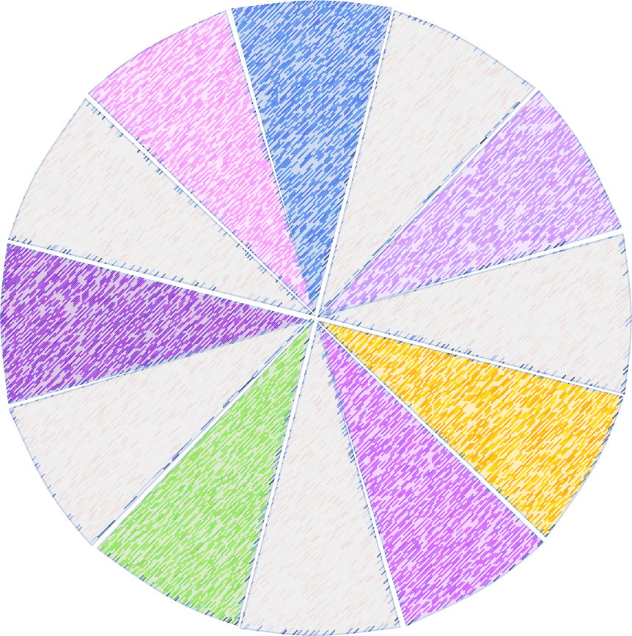
1
7
2
6
3
5
4

Slide 18
